Slide 1

Customer Shopping Behavior Analysis
This project analyzes customer shopping behavior using transactional data to uncover insights into spending patterns, customer segments, product preferences, and subscription behavior.

Slide 2

Project Overview and Dataset Summary
Project Goal
Dataset Snapshot
Analyze 3,900 purchases to guide strategic business decisions through data-driven insights.
Size
Key Features
3,900 Rows, 18 Columns.
Demographics, Purchase Details, Shopping Behavior (e.g., Discount, Previous Purchases).
The analysis covers spending, segmentation, product preferences, and subscription trends.
Missing Data
37 missing values in the Review Rating column.

Slide 3





Exploratory Data Analysis (EDA) in Python
The initial phase focused on data preparation, cleaning, and feature engineering.
Data Loading & Exploration
Imported dataset using pandas; checked structure and summary statistics.
Missing Data Handling
Imputed missing Review Rating values using the median rating per product category.
Feature Engineering
Created age_group and purchase_frequency_days columns.
Database Integration
Loaded the cleaned DataFrame into PostgreSQL for structured SQL analysis.

Slide 4
SQL Analysis: Revenue and Discount Insights
Revenue by Gender
Discount Dependency
Male customers generated significantly higher total revenue.
Products with the highest percentage of discounted purchases:
Gender
Revenue
Hat
Female
$75,191
50.00% discount rate
Male
$157,890
Sneakers
49.66% discount rate
Coat
49.07% discount rate

Slide 5

SQL Analysis: Product Performance
Top 5 Products by Rating
Top Products Per Category
Identifying the highest-rated items based on average review scores.
The most frequently purchased items within the major categories.
1
Accessories: Jewelry (171 orders)
Clothing: Blouse (171 orders)
Gloves
Footwear: Sandals (160 orders)
Avg. Rating: 3.86
Outerwear: Jacket (163 orders)
2
Sandals
Avg. Rating: 3.84
3
Boots
Avg. Rating: 3.82
4
Hat
Avg. Rating: 3.80
5
Skirt
Avg. Rating: 3.78

Slide 6

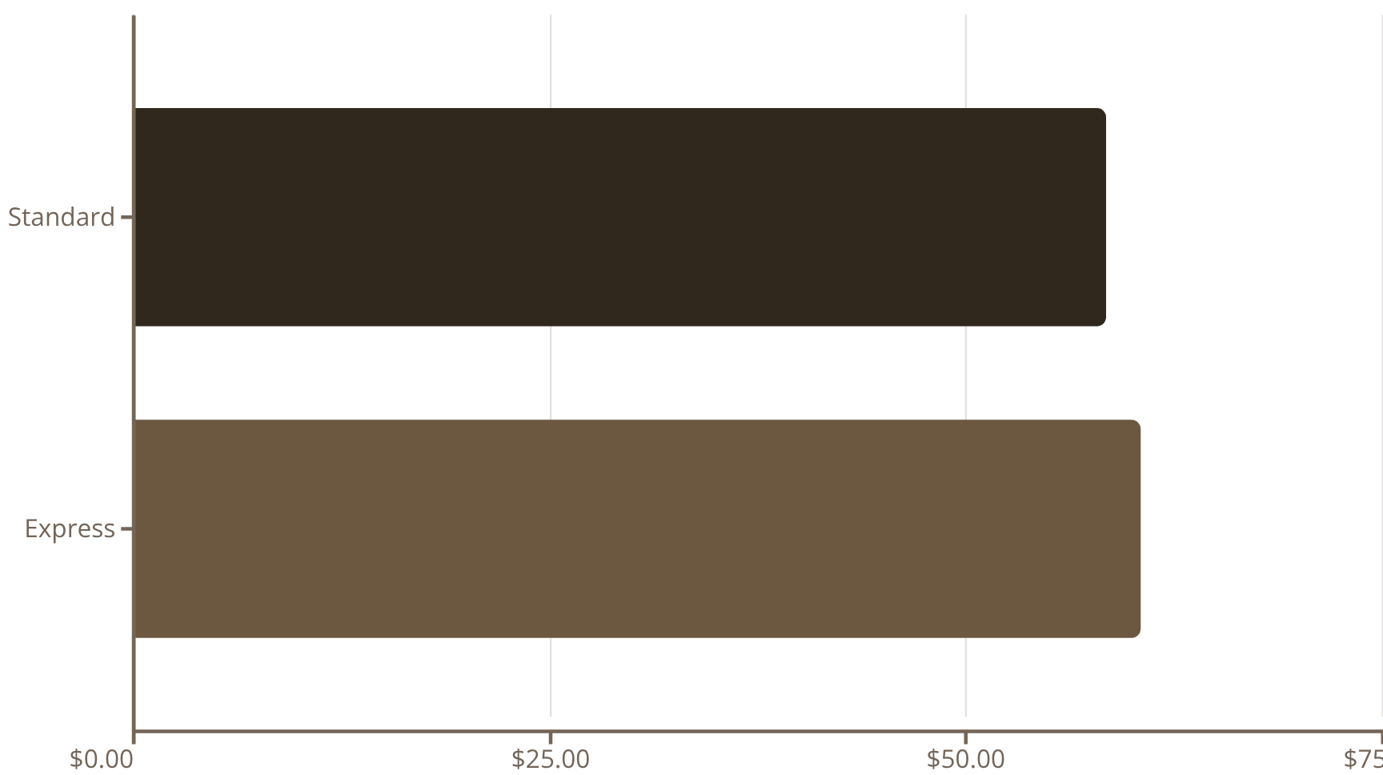
SQL Analysis: Shipping and Spending
Shipping Type Comparison
Customers using Express Shipping have a higher average purchase amount.
High-Spending Discount Users
839 customers used a discount but still spent above the average purchase amount, indicating effective discount targeting for high-value transactions.

Slide 7
Subscription Status and Customer Loyalty
Subscribers vs. Non-Subscribers
Repeat Buyers & Subscriptions
Non-subscribers account for the majority of customers and total revenue, but the average spend is similar.
Customers with more than 5 purchases are significantly more likely to be non-subscribers (2,518 non-subscribers vs. 958 subscribers).
Status
Customers
Avg. Spend
Total Revenue
Customer Segmentation
Loyal
Yes
1,053
$59.49
$62,645
3,116 Customers
No
2,847
$59.87
$170,436
Returning
701 Customers
New
83 Customers

Slide 8
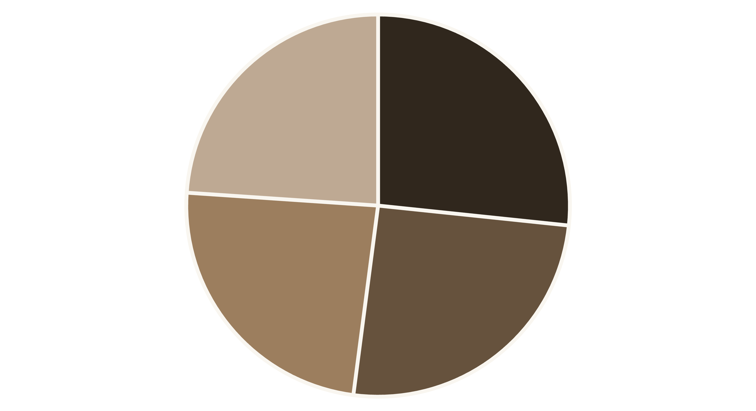
Revenue Contribution by Age Group
Young Adults and Middle-aged customers are the highest revenue contributors.
Young Adult
Middle-aged
Adult
Senior

Slide 9
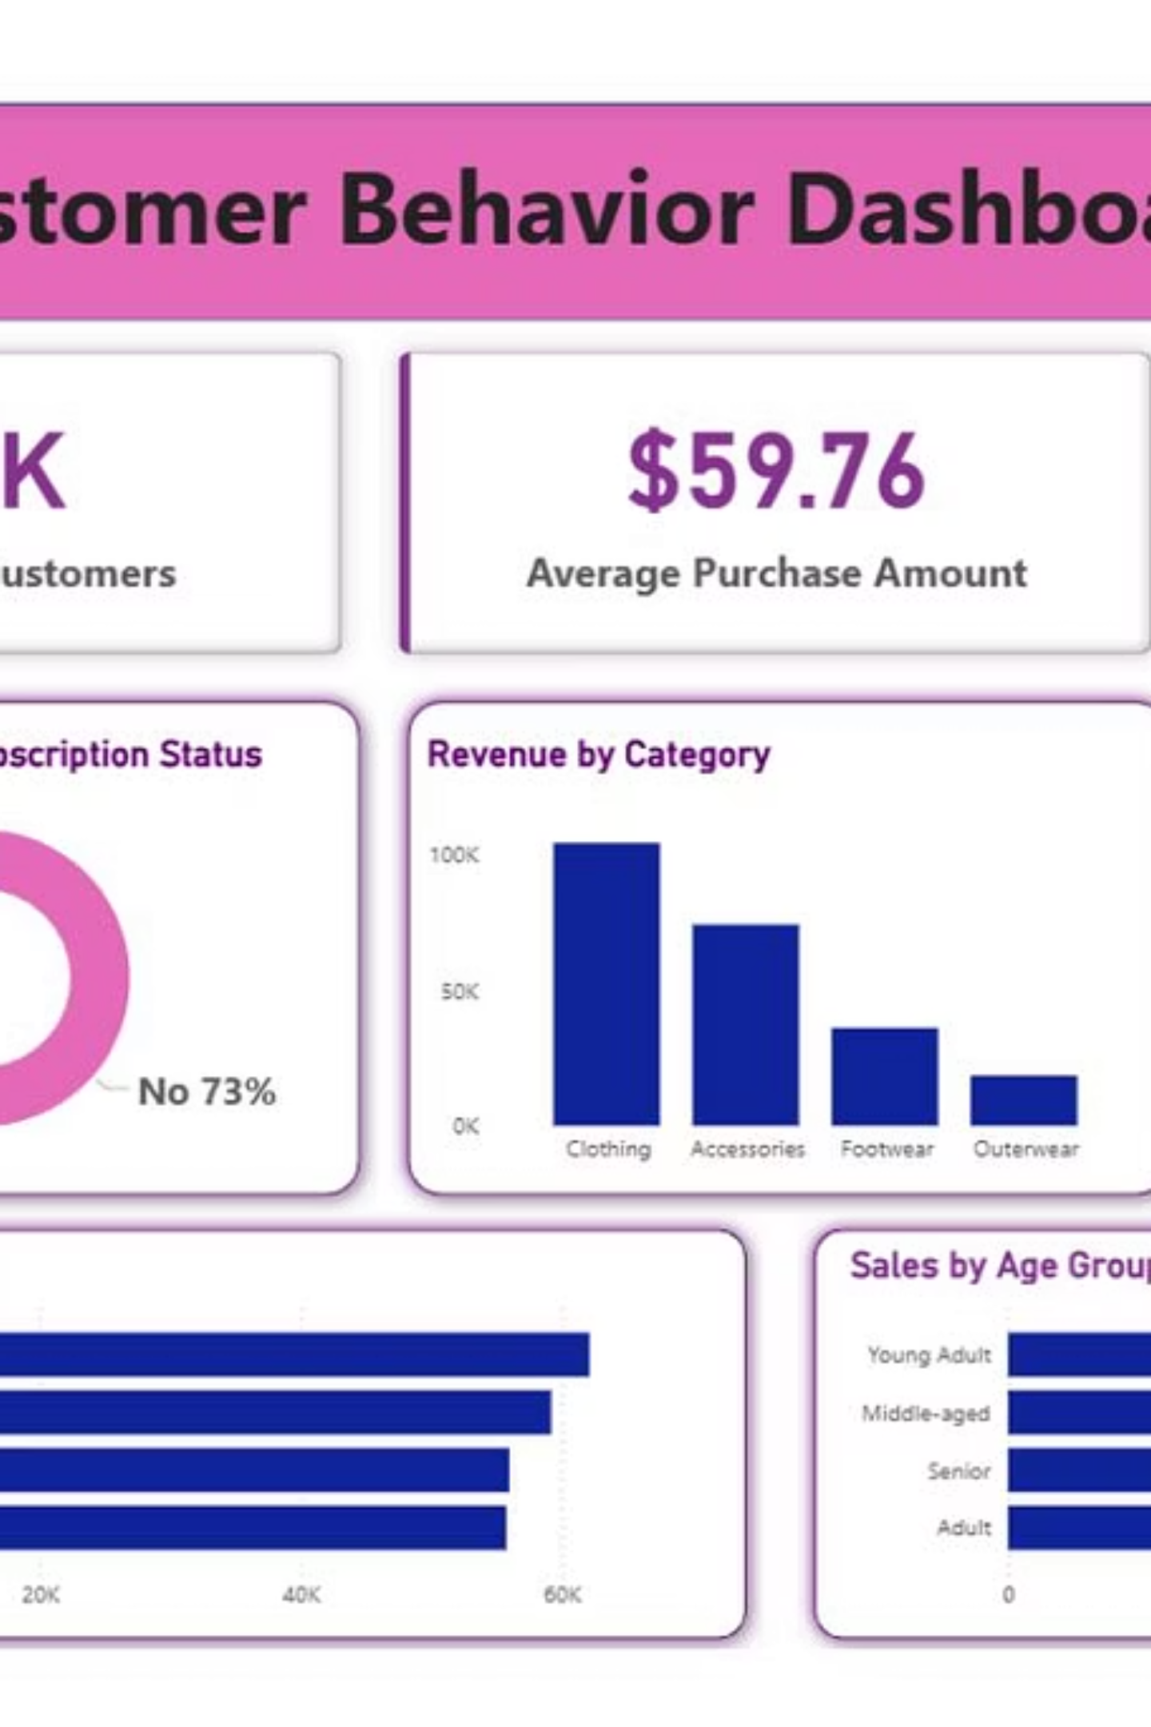
Visualizing Key Insights (Power BI)
An interactive dashboard was created in Power BI to present the findings visually and allow for deeper exploration.
The dashboard integrates all key metrics, from revenue breakdown to customer segmentation, providing a single source of truth for strategic planning.

Slide 10

Strategic Business Recommendations
Boost Subscriptions
Customer Loyalty
Review Discount Policy
Promote exclusive benefits to increase subscriber conversion, especially among repeat buyers.
Implement programs to reward repeat buyers and move them into the "Loyal" segment.
Balance sales boosts from discounts with the need for margin control.
Targeted Marketing
Product Positioning
Focus campaigns on high-revenue age groups (Young Adult, Middle-aged) and Express Shipping users.
Highlight top-rated products (e.g., Gloves, Sandals) and best-sellers in marketing campaigns.

